Slide 1
Noise-Consistent Siamese-Diffusion for Medical Image Synthesis and Segmentation
Sahel Azzam, Samuel Abiola, Daniel Diaz Santiago, Ynes Ineza, Salish Kumar
Notes:
Ynes

Slide 2
Problem Statement & Motivation
Medical image segmentation needs more data
Traditional diffusion models lack morphological fidelity
Show the contrast: noisy output vs. expected high-quality medical images

Slide 3
Original Siamese-Diffusion Method
Brief overview of Qiu et al. approach
Two branches: Mask-Diffusion + Image-Diffusion
Key innovation: Noise Consistency Loss
Simple architecture diagram

Slide 4
Our Implementation Approach
Replication methodology
Technical stack: PyTorch + Stable Diffusion v1.5
Key parameters and setup
Dataset: Polyps (Kvasir + CVC-ClinicDB)

Slide 5
Diffusion
Diffusion models are tools used to generate image mask pairs, widely used to expand data sets for medical image segmentation tasks.
Typically, generating medical images involves using masks to indicate the lesion areas as prior controls injected into the diffusion model
Diffusion models consists of a diffusion process and a denoising process.
Notes:
Salish

Slide 6
Siamese-Diffusion model
The paper proposes the resource-efficient Siamese-Diffusion model, which trains the diffusion model under varying prior controls.
When guided by a mask alone, this process is termed Mask-Diffusion, and when guided by both the image and its corresponding mask, it is called Image-Diffusion.
To alleviate the inherent issues of Image-Diffusion, the paper introduced a Noise Consistency Loss, enabling the noise predicted by Image-Diffusion to act as an additional anchor, steering the convergence trajectory of Mask-Diffusion toward a local minimum with higher morphological fidelity in the parameter space

Slide 7
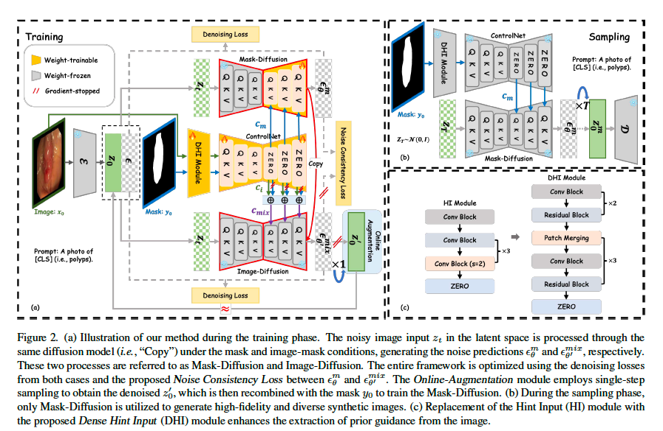
Training Phase Model
Notes:
Sam

Slide 8
How Siamese-Diffusion Works
Dual-Branch Training Architecture
1. Mask-Diffusion Branch
Input: Segmentation mask
Goal: High diversity
Limitation: Low fidelity
2. Image-Diffusion Branch
Input: Image + mask (via dense hint)
Goal: High fidelity
Limitation: Low diversity

Slide 9
Key Innovation – Noise Consistency Loss
Key Innovation: Noise Consistency Loss
Forces Mask-Diffusion to learn from Image-Diffusion's superior noise predictions
L_total = L_diffusion + λ × ||ε_mask - ε_image||²
Result: Mask-Diffusion inherits high fidelity while maintaining diversity
Inference: Best of Both Worlds
During sampling: Only Mask-Diffusion branch is used
Input: Segmentation mask only
Output: High-fidelity + diverse synthetic medical images
Achieves the impossible: High fidelity AND high diversity from mask-only conditioning

Slide 10
Training phase
Training is done on three Public medical Datasets - Polyps, ISIC2016 and ISIC2018.
Segmentation performance is evaluated using weighted mDice(%) and mIoU(%).
Evaluation metrics used are FID, KID, CLIP-1, LPIPS, CMMD and the Mean Opinion Score (MOS)
They introduce the Noise consistency Loss they select wc=1.0 as the optimal stable default.

Slide 11
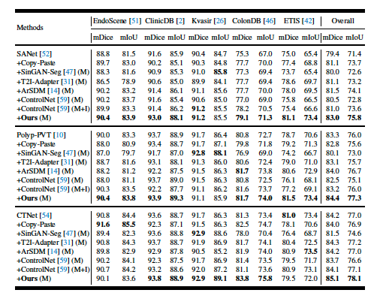
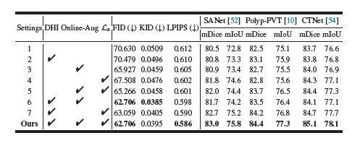
Results

Slide 12
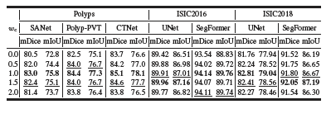
Results

Slide 13
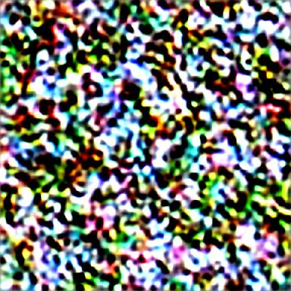
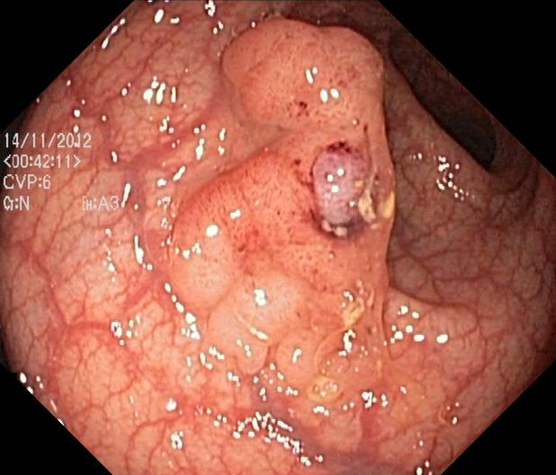
Expected Vs. Actual Results
Left: Your noisy output image
Right: Expected clean polyp image from paper
Clear visual impact of the problem
Notes:
Sahel

Slide 14

Sample result

Slide 15
What Could Be The Issue
Sampling configuration problems
Training convergence issues
Data preprocessing gaps
Architecture implementation details

Slide 16
Debugging Strategies
Systematic approaches we plan to take:
Start with simpler baseline
Verify loss computations
Check gradient flow
Compare with ControlNet baseline
Notes:
Daniel

Slide 17
Lessons Learned
Importance of implementation details in papers
Need for incremental validation
Reproducibility challenges in deep learning
Domain-specific considerations for medical imaging

Slide 18
What could be improved
Our implementation:
Start from verified ControlNet baseline
Use lower resolution images for faster debugging
Inject mask‑branch features via cross‑attention into the image UNet
Predict soft masks with a KL‑divergence uncertainty loss
Original implementation:
Expand to 3D/grayscale modalities (CT and MRI)
Promote expert feedback (medical professionals)

